Slide 1
LEARNING DIFFERENTIAL EQUATIONS FOR STOCK MARKET PREDICTIONS
CS771 - Course Project
Under the guidance of
Prof. Piyush Rai
Notes:
A warm afternoon to all. I along with my group members am here to present our project work on the topic Learning Differential Equations for Stock Market Predictions.

Slide 2
Group Members
Aditya Singh (170056)
adisingh@iitk.ac.in
Nishtha (180489)
nishthaa@iitk.ac.in
Vartika Gupta (180849)
vartikag@iitk.ac.in
Vaidic Jain (180845)
vaidic@iitk.ac.in
Notes:
These are the contact info for the team members

Slide 3
PROBLEM DESCRIPTION
Problem Statement:
Improving existing methods of ML based Stock prediction using Differential Eqs.
Task:
To implement the following 3 models on the given stock price dataset, and compare the results obtained:
LSTM based Model (base model, popular for stock prediction)
Neural ODE based model
Neural SDE based model
Notes:
So we know that stock price prediction has always gained high significance in the financial world due to the large profits margins it provides the investors. But stock trends are as random and chaotic as they can be and modelling them is a big task even with so much advancement in ML. So in our project we took this task.
So we firstly devised an LSTM based Recurrent neural network for the task since it has been widely popular for such data. Next, we dug deeper into much newer research fields in Machine Learning and we developed Neural ODE and SDE based models.
So lets find out how they all went

Slide 4
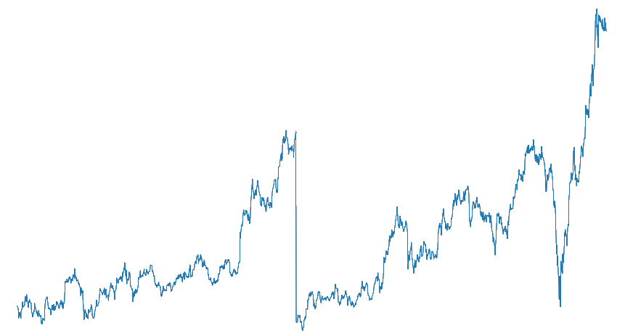
DATA
Stock price dataset of Reliance Industries Ltd. from January 2015 to August 2020. Source: NSEpy library for Python
Features(columns) in the Dataset:
Date, Symbol, Series, Prev. Close, Open, High, Low, Last, Close, VWAP, Volume, Turnover, Trades, Deliverable Volume, %Deliverable
Extracted Features:
Date, Open, High, Low, Close
(Goal) Final feature to predict:
The closing price of the stock each day
Notes:
So the dataset we took was the Stock Price dataset of Reliance Industries for almost 5 years since january 2015 to August 2020. Our original datset consisted of 15 columns as shown here on the left. The columns of our interest that we used for our predictions in each of the three models which were - Date, Opening Price, Closing Price, Highest Price of that day and Lowest price of that day. Each row of the dataset represented values corresponding to these columns for each day. The eventual goal was to predict the closing price of the stock for each day using this information to train our model.

Slide 5
DATA
Training Data
Size: 1121 (80%)
Test Data
Size: 280 (20%)
(Closing)
Notes:
So here is a pictorial representation of our dataset where on x - axis we have the days and on vrtical axis we have the closing stock price for each day. We split the data in a 80 - 20 ratio with 80% training dataset.

Slide 6
GENERATING INPUT FEATURES
A common input taken for training ML models for stock prediction is - Sequence of close prices of past K days
Y^{n} = p^{n}
X^{n} = [p^{n-K}, p^{n-K+1}, … , p^{n-2}, p^{n-1}]^{T} p^{n} is closing price of RIL on n^{th} day
Notes:
In stock prediction, we usually use windows of data as input. Well the intuition is that past few months or even weeks or in other words recent events hold a higher significance in time related predictions. And so it is a common practice in time related predictions to take a sequence of past few events to be fed as input to the model.

Slide 7
LSTM Model
1
Long Short-Term Memory based predictions
Notes:
So firstly, we will go through the LSTM model. We used this over regular RNN due to the short term memory problems in general RNN.

Slide 8
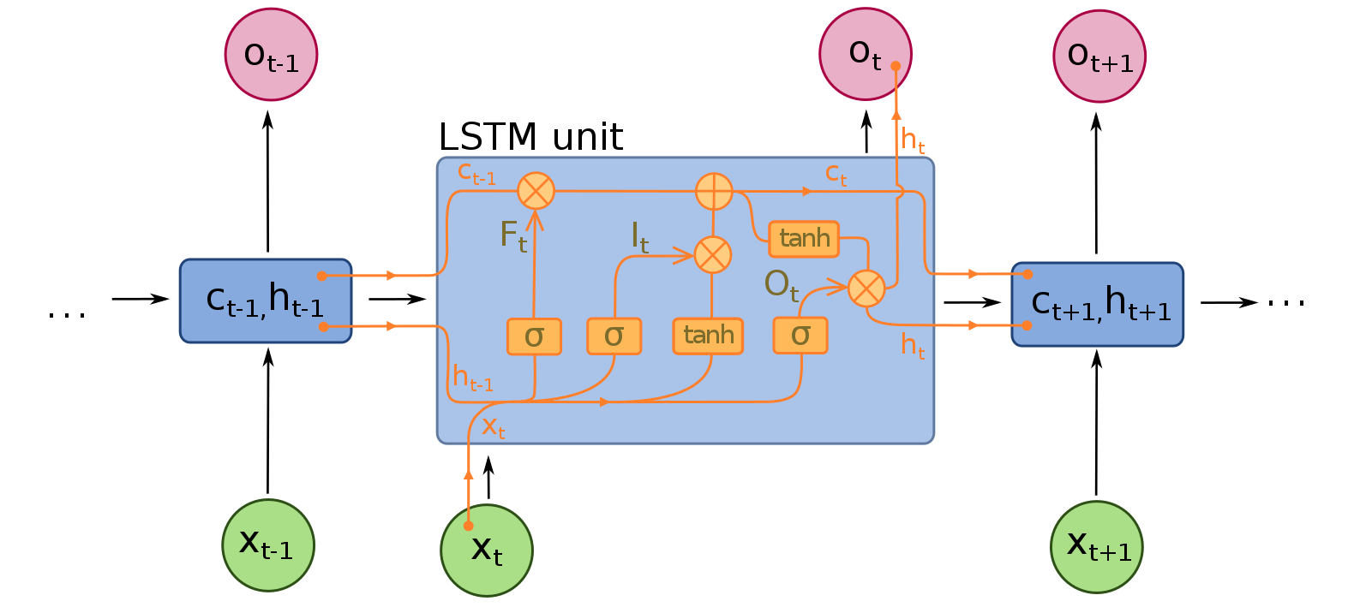
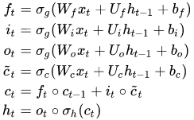
Quick brief about LSTM
Image Courtesy - François Deloche, via Wikimedia Commons, Wikipedia
Notes:
So the core concept of LSTM’s lies in the cell state and it’s various gates. The cell state act as a transport highway that transfers relative information down the sequence chain. It basically acts as the “memory” of the network. So even information from the earlier time steps can make it’s way to later time steps, reducing the effects of short-term memory. The information gets added or removed to the cell state via gates which can learn what information is relevant to keep or forget during training.
So we have a forget gate which decides which information should be kept or not. Next we have an input gate which updates the cell state based on previous hidden state and current input. Then we update the cell state using the output information of the forget gate and the input gate. Next we have the output gate which decides what the next hidden state should be.
Here x_t denotes the input vector to the LSTM unit, W, U and b are the weight matrices and the bias vectors we need to learn during training. The gates here ue sigmoid activation functions. Here we have 4 activation vectors of the gates which include forget gate, input gate, output gate, cell input activation vector, cell state vector and then hidden state vector or the output of LSTM cell.

Slide 9
DATA PREPROCESSING
Train/Test Split: (80% - Train Set and 20% - Test Set)
Parameters: Size of input features (K) - 64
Normalization: (Standard Scaler i.e. 𝑥_{scaled} = (𝑥 - 𝜇)/𝜎 ∀ 𝑥)
Notes:
Firstly we process the dataset as per requirements. We split the dataset in 80 to 20 ratio. Then we had a sequence window of length 64 as inputs and we normalized the data using standard scaler which normalized using the mean and std deviation as x - mu / sigma.

Slide 10
MODEL
INPUT :
LSTM
(64)
DROPOUT
(0.25)
Dense1
(64)
Dense2
(32)
Dense3
(16)
Dense4
(1)
: OUTPUT
Activation: ReLU
Notes:
Here we have our model architecture. So our neural net comprises a 64 unit LSTM layer followed by a 25% dropout layer and then 4 fully connected dense layers implemented using tensorflow framework. The layers use ReLU activation. The model takes a 64 length sequence (past recent 64 days) as input and predicts the closing price of the day output.

Slide 11
1,121 (~80%)
280 (~20%)
32
MSE
150
Adam
Size of Training Set
Size of Test Set
Batch Size
Loss
Epochs
Optimizer (default values)
Notes:
So here are some parameters/hyperparameters. Already spoke about the train/test size. We used 32 as batch size for training and we trained for maximum 150 epochs and used early stopping. We used MSE loss function and Adam optimizer with default values as our optimization function.

Slide 12
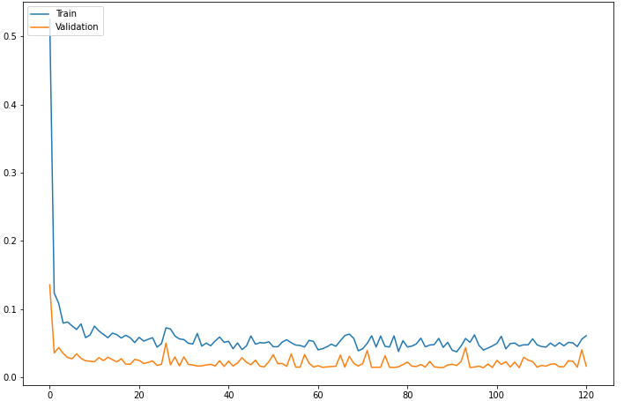
Training and Test Loss
Test Loss
Training loss
MSE Loss
Epoch
Notes:
This is the plot for the mean square loss for each epoch as we process for more and more epochs. It tends to have a bit of noise which is due to the fact that loss is for batch gradient descent. But overall we have a decreasing trend which is desirable.

Slide 13
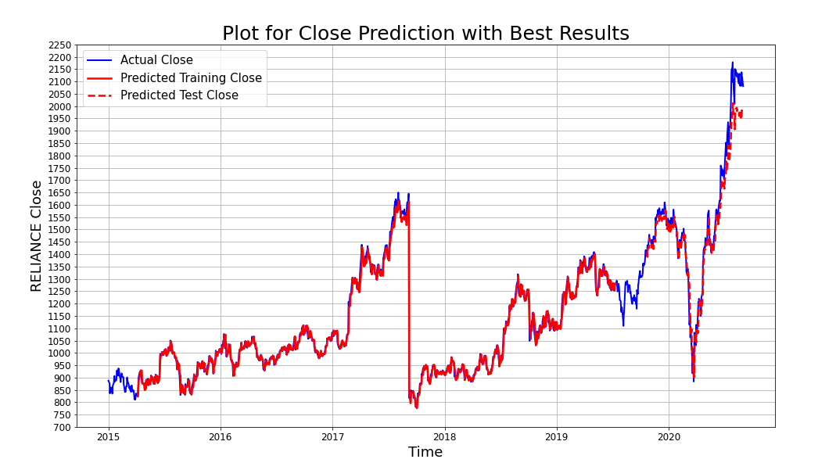
Notes:
This is our final prediction plot for the train and test set by our model. As we can see the train prediction here is totally overlapping. The test prediction is also pretty good except that slight deviation towards the end.

Slide 14
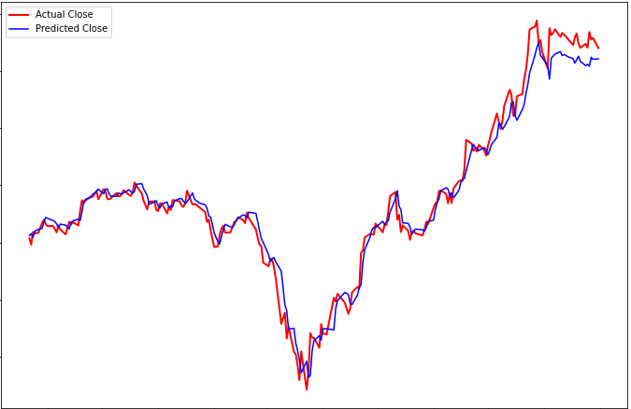
Test Prediction (Closer look)
0.0886
Actual Close
Predicted Close
MSE (Test Set)
Notes:
Here is a closer look to our test predictions. We had a MSE loss of 0.0886 for our test set which was pretty good.
So next we will look into ODE/SDE models to see if we could improve upon this and i handover to vartika.

Slide 15
Neural ODE Model
2
Ordinary Differential Equation based predictions
Notes:
After having a look at the LSTM model with an MSE loss of 0.0886, to improve the accuracy, we worked on implementing 2 models of advanced ODE solving techniques namely Neural Ode and Neural SDe. I will be elaborating on the Neural ODE implementation.

Slide 16
Are stock prices time variant?
No paper on using Neural ODE for stock prediction
Needed insight for using time as a parameter or not?
Thought experiment - if the conditions of the market today were exactly replicated 10 years earlier, will the market behave the next day as it will tomorrow?
Conclusion: Stock prices are time invariant
Notes:
Since we did not find any paper focussing on using Neural ODE for stock prediction, our first challenge was whether ODE can be implemented for a time series data like stock prices. So, we hypothesized a situation in which if the conditions of the market today were exactly replicated 10 years earlier and the next day’s market behaviour is seen. Then, will it be identical to tomorrow’s behaviour? Since we can expect them to perform similar on that day as it will perform tomorrow based on it’s past values, we concluded that the stock prices are time invariant and hence, time cannot be used a parameter

Slide 17
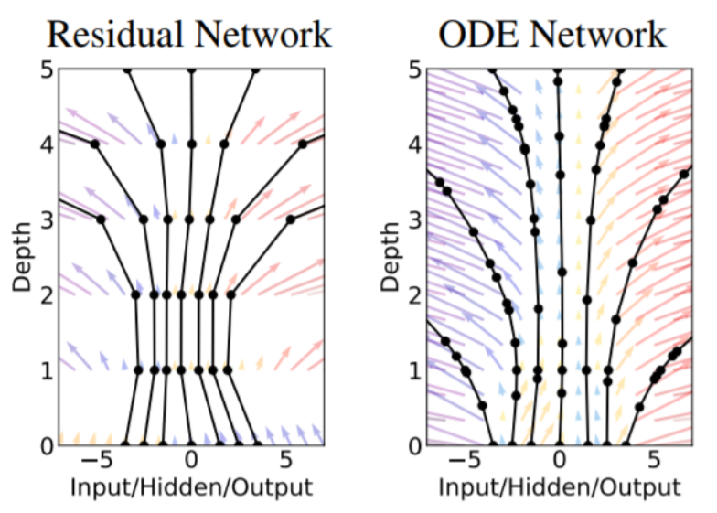
Why use ODE
Advanced ODE solvers differ from the simple Euler method in multiple aspects:
Higher order methods - ODE solvers perform multiple function evaluations for each step of solving the ODE (which leads to more accurate solutions).
Adaptive step-sizes - ResNets are evaluated at fixed intervals of "time" or layer depth. However, ODE-nets can evaluate the hidden activations or state at varying time intervals adapting to the complexity of the dynamics.
Image Courtesy: Chen (et.al) Neural Ordinary Differential Equations [https://arxiv.org/abs/1806.07366]
Notes:
The 2 main reasons for using advanced ODE solvers are that they perform multiple evaluations of the functions for each step of ODE and hence increase the accuracy. The second reason is the adaptive step sizes. As you can see in the picture on the right, a regular neural network is evaluated at fixed intervals of time and at fixed intervals of layer depth and do not take into account the complexity of the dynamics of the model. Whereas an ODE network adapts to the model and evaluates according to the previous outputs of the model at previous layers.

Slide 18
Some more benefits of ODE Networks
More memory efficient - compared to conventional ResNets and require fewer parameters.
Tolerance level - as a parameter controls how accurate the solution is, at the cost of more function evaluations. It is a tradeoff between performance and speed.
Continuous normalizing flows - The continuous nature of the ODE-net as opposed to a discrete network greatly simplifies and speeds up certain computations in training.
Notes:
Some general benefits of ODE networks are that they are more memory efficient and they have a continuous nature so using ODEs as a generative model allows us to make predictions for arbitrary time points t1...tM on a continuous timeline.
Their tolerance level can be adjusted and is a tradeoff between performance and speed. For example, ODE-nets can be trained with very low tolerance values which can be later relaxed at test time for faster inference.

Slide 19
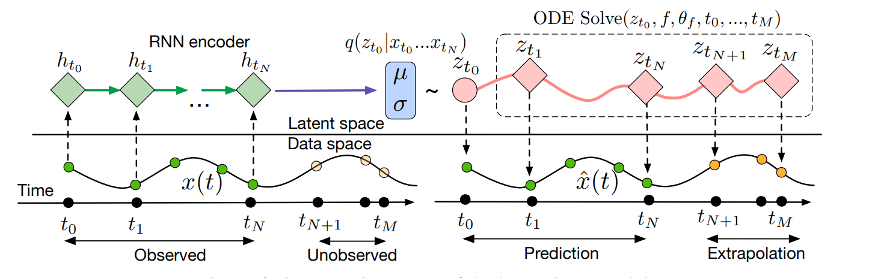
Computational Graph of Latent ODE
...
Image Courtesy - Chen et. al. Neural Ordinary Differential Equations (arxiv.org)
Notes:
This is the general structure of a Latent ODE model that is described in the paper mentioned that we used as a reference.
This model represents each time series by a latent trajectory. Each trajectory is determined from a local initial state, zt0. Given observation times t0, t1, . . . , tN and an initial state zt0 , an ODE solver produces zt1 , . . . , ztN , which describe the latent state at each observation. Function f is a time-invariant function that takes the value z at the current time step and outputs the gradient: ∂z(t)/∂t. The function is parameterized using a neural net.
The recognition net uses an RNN, which consumes the data sequentially backwards in time. Then the ODE solver uses the latent states z, the time invariant function f and the observation times to predict the future stock prices.

Slide 20
MODEL
TORCHDYN
Module for solving ODEs
INPUT :
Neural ODE
(22, 22)
FC
(22,1)
: OUTPUT
Neural ODE -
> solver - dopri8
> absolute tol - 1.4e-5
Dense1
(22,64)
Dense2
(64,128)
Dense3
(128,64)
Dense4
(64,22)
Notes:
We used the shown model taking into reference the model discussed in the previous slide. We have used the TorchDYn module to solve ODEs with a dopri8 solver and an absolute tolerance of 1.4e-5. We used dopri8 solver because it works better in terms of speed and accuracy compared to other solvers of lower orders.
The Neural ODE is a 2-D solver with 4 dense layers.

Slide 21
1099 (~80%)
22
MSE
0.001, 0.1
600
Adam
Size of Training Set
Sequence Length (K)
Loss
Learning Rate, L2 regularizer (weight decay)
Epochs
Optimizer
Notes:
These are some of the parameters and hyperparameters that we used in the model. The size of the input training data is 1099 which is approximately 80% of the total dataset. We used the sequence length of 22 and MSE loss function with a learning rate of 0.001 and an L2 regularizer of 0.1 . We trained the model using Adam optimizer with 600 epochs.

Slide 22
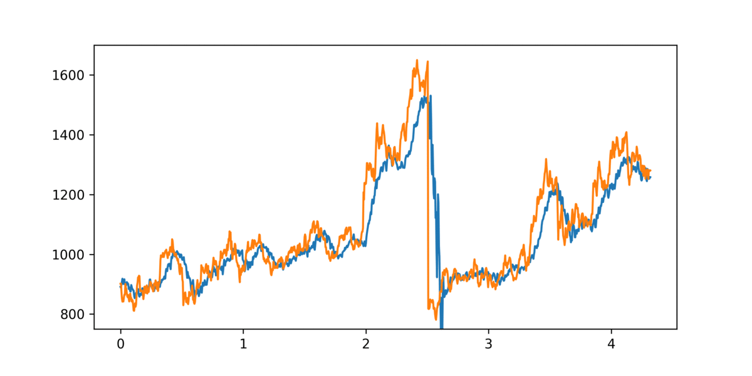
Training for 600 epochs
--- - Actual Close
--- - Predicted Close
Closing Price
Time in per year (1 year ~252 trading days)
Notes:
This plot shows how well the the model fits on the training data for 600 epochs. The blue graph depicts the predicted loss that closely resembles the orange graph of the true closing values of the stock price.

Slide 23
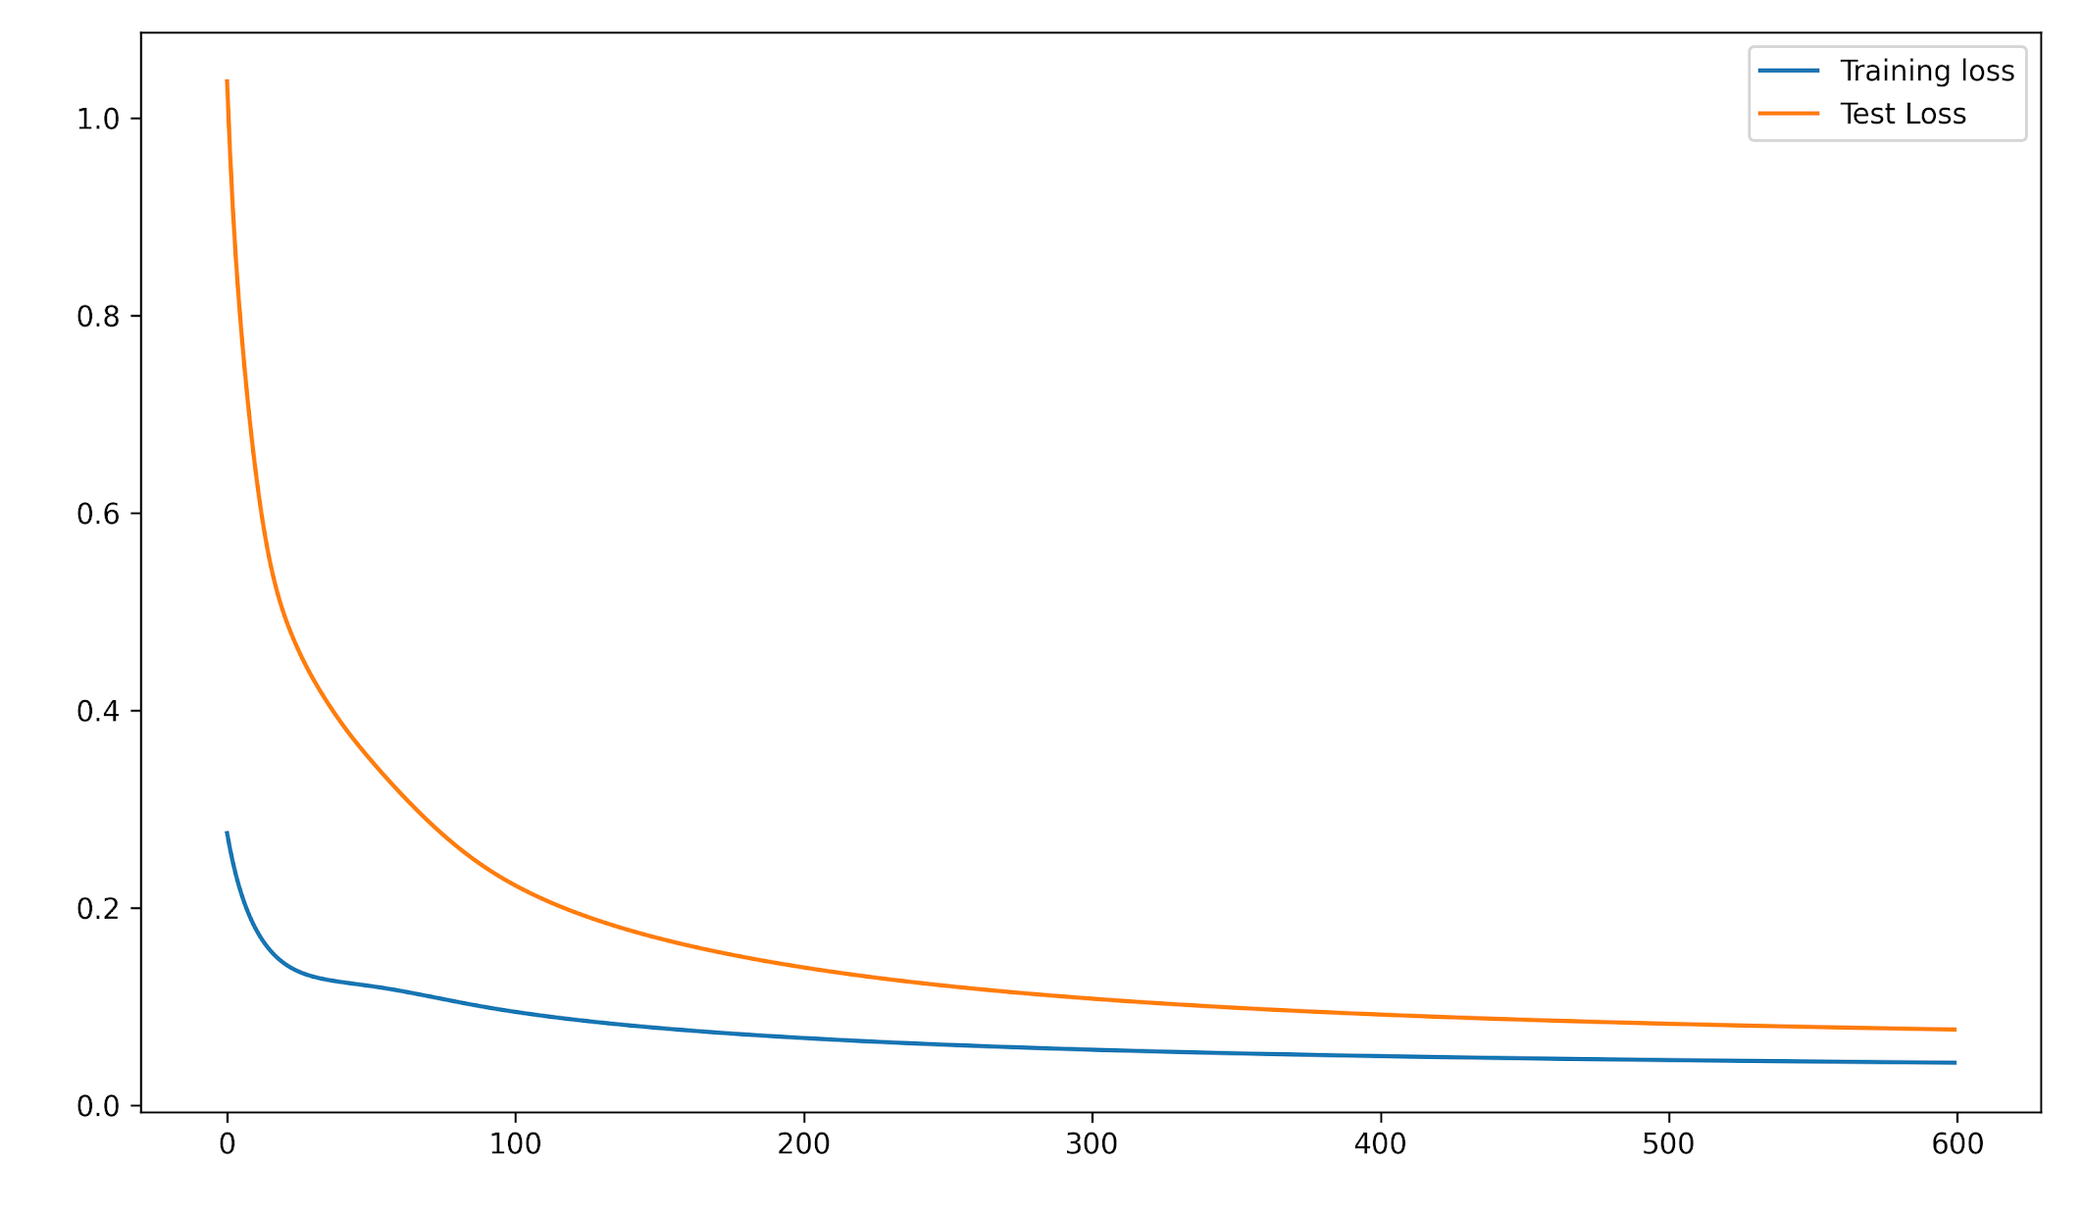
Training and Test Loss
--- - Test Loss
--- - Training loss
MSE Loss
No. of Epochs
Notes:
This is the plot for the mean square loss of the training and test data for each epoch. Note that the plot shows a smooth decreasing trend

Slide 24
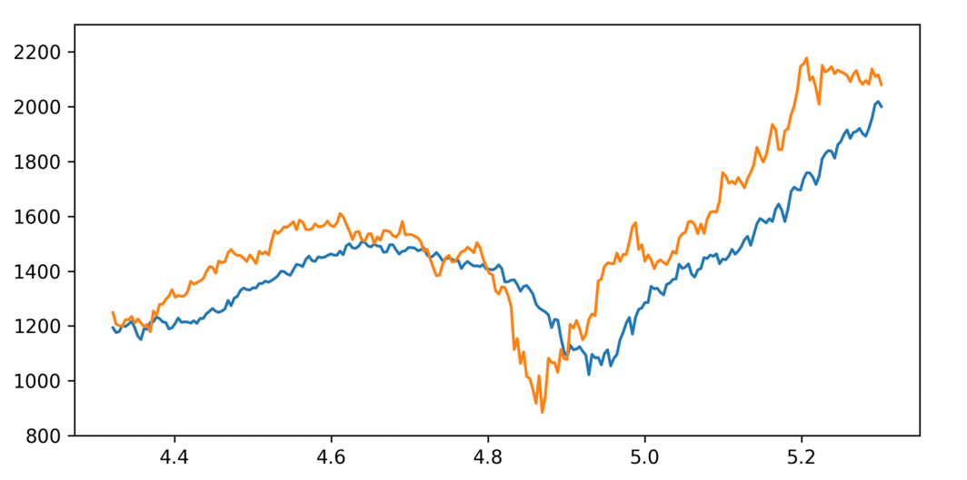
Test Prediction
0.07701
Actual Close
Predicted Close
Closing Price
MSE (Test Set)
Time in per year (1 year ~252 trading days)
Notes:
This is our final plot that shows the predicted values of the test dataset in blue colour. It aligns with the actual values considerably well and note that the slight deviation that we observed in the LSTM model does not exist in Neural ODE. Also, note the reduced MSE loss of 0.07701.

Slide 25
OBSERVATIONS
Marginally better prediction than LSTM
Very slow training process
Can overfit easily if not regularized adequately
Risk of instability for low tolerance
Notes:
These are some observations of the model. Neural ODE performed marginally better than LSTM but the training process is very slow. Hence time can be considered as a tradeoff for better accuracy in this case. Also, we realized that the model can overfit easily if not regularized adequately. Furthermore, If we want low tolerance then there is a risk of instability. Now I would like to handover to Aditya.

Slide 26
Neural SDE Model
3
Stochastic Differential Equation based predictions
Notes:
Thank you and goodafternoon. After learning the success of Neural ODE, we were further motivated to try out neural SDE proposed in July 2020 for predicting stock prices.

Slide 27
Why use SDE
Neural SDE network naturally incorporates various commonly used regularization mechanisms based on random noise injection. In easilier words we can also say that SDE is just an ODE with noise.
Neural SDE model can stabilize the prediction of Neural ODE by injecting stochastic noise.
Neural SDE network can achieve better generalization than the Neural ODE and is more resistant to adversarial and non-adversarial input perturbations.
Neural SDEs allow consistent calibration under both the risk-neutral and the real-world measures. Thus the model can be used to simulate market scenarios needed for assessing risk profiles and hedging strategies.
Source:
Li et al. Scalable Gradients for Stochastic Differential Equations https://arxiv.org/abs/2001.01328
Notes:
First question would be why would we want to use SDE over ODE. Here are some points that were suggested in the paper mentioned at the bottom.
1) Stablizes ODE by injecting stochastic noise and doesnt let it overfit as well.
2) Robust to adversarial input perturbation.
3) SDE have been very popular in the finance world and we know for with good confidence it works for long term prediction

Slide 28
MODEL
FC activation: ReLU
UPSAMPLING:
INPUT :
FC1
(22 , 50)
: OUTPUT
DRIFT:
INPUT :
FC1
(50 , 50)
: OUTPUT
DIFFUSION:
INPUT :
FC1
(50, 100)
FC2
(100, 1)
: OUTPUT
SDE: dY = μdt + σdW ~ μdt + σ*√t*N(0,1)¹
out = out + self.drift(t, out)*self.deltat + diffusion_term * math.sqrt(self.deltat) * torch.randn_like(out).to(x)
¹https://sites.me.ucsb.edu/~moehlis/APC591/tutorials/tutorial7/node2.html

Slide 29
1e-4, 0.1
22
MSE
0.9, 5e-4
200
SGD
Learning rate, LR Decay
Sequence Length (K)
Loss
Momentum, L2 regularizer (weight decay)
Epochs
Optimizer (default values)

Slide 30

Training for 200 epochs
--- - Actual Close
--- - Predicted Close
Closing Price
Time in per year (1 year ~252 trading days)
Notes:
To note: Converges much quickly compared to Neural ODE
X axis is in continuous scale

Slide 31
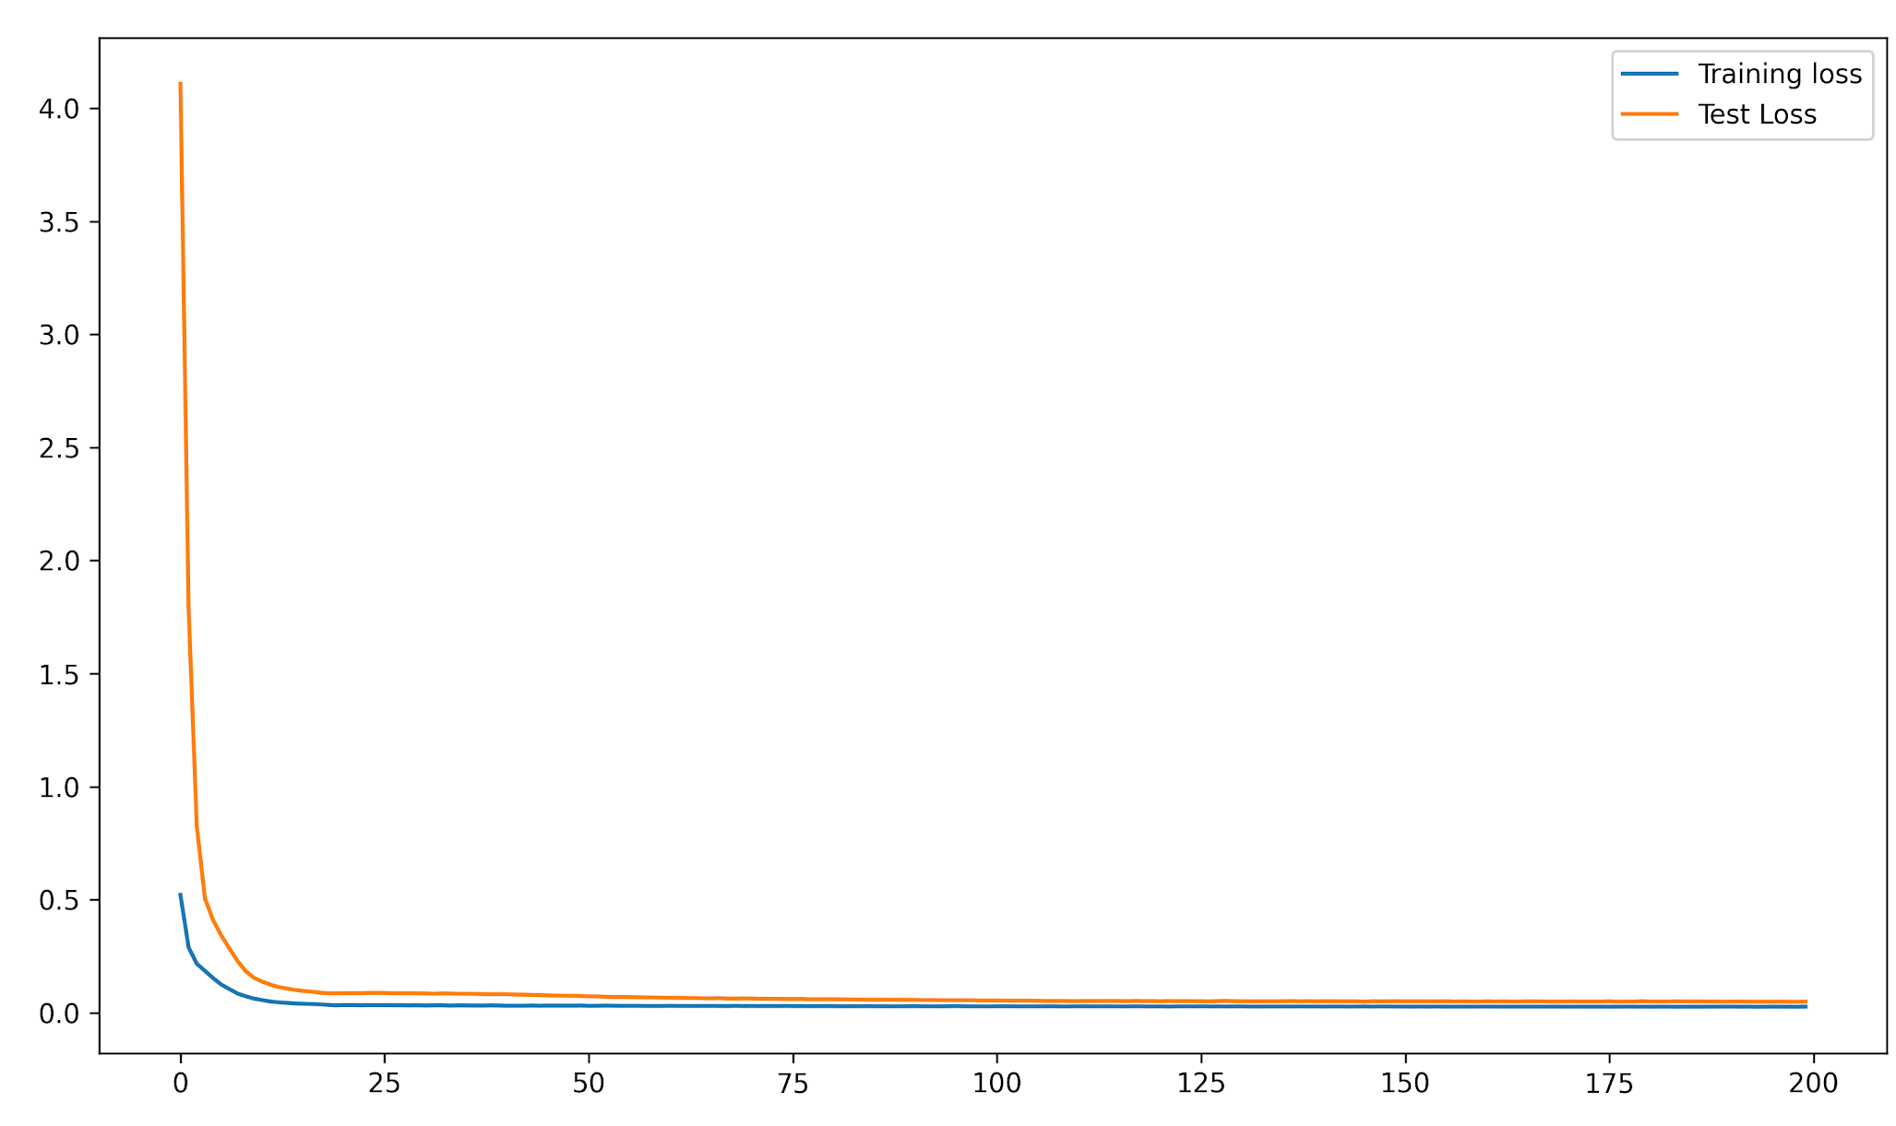
Training and Test Loss
--- - Test Loss
--- - Training loss
MSE Loss
No. of Epochs

Slide 32
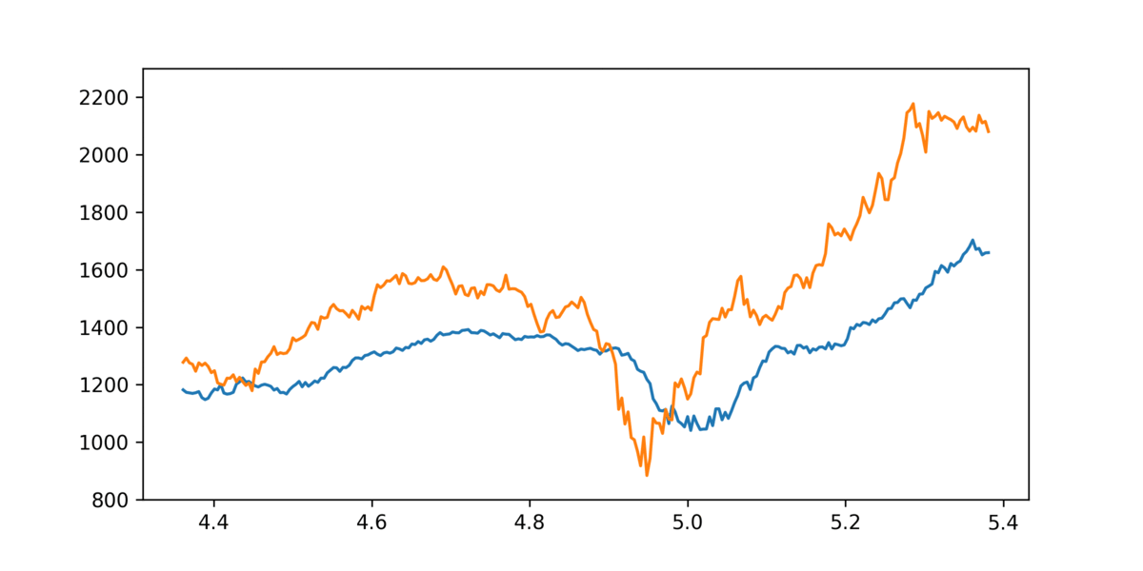
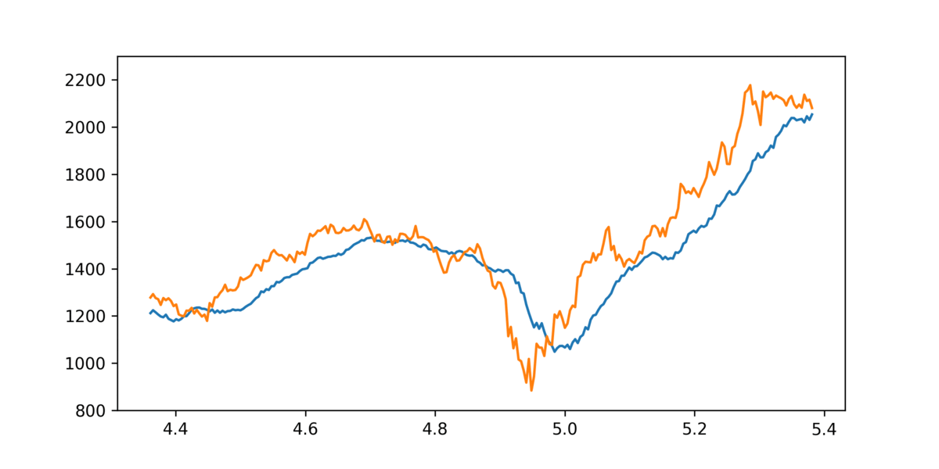
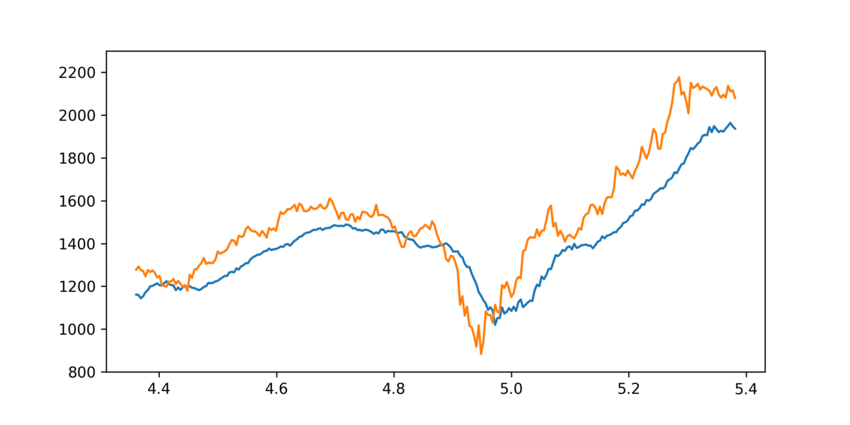
Prediction Plots for multiple executions
X-axis: Time in per year (1 year ~252 trading days)
Y-axis: Closing price
Notes:
Because of presence of randomess

Slide 33
Test Prediction (Best Results)
0.04986
Actual Close
Predicted Close
Closing Price
MSE (Test Set)
Time in per year (1 year ~252 trading days)
Notes:
It converges very quickly
MSE loss about half of LSTM
MSE loss lesser than Neural ODE by 0.02

Slide 34
Major Observations
Much better fit than LSTM or Neural ODE
Very fast convergence
Basic Euler method used for updation, More robust update techniques like Runge-Kutta method, Milstein method, DOPRI method, etc, can be used for better results.
Presence of random process gives different trained results each time
Can be further improved by using latent models

Slide 35
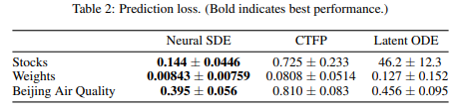
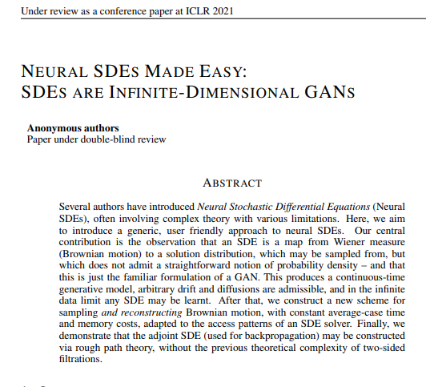
How recent is using Neural SDE for stock predictions?
Currently under double blind review
Uses Neural ODE and SDE to predict Alphabet (Google) stocks
Predicts their SDE’s model performance as far superior to ODE
Code not made public yet for us to learn and improve :(
https://openreview.net/forum?id=padYzanQNbg
Notes:
We couldn’t find any published modelled
ODE and SDE for google

Slide 36
THANKS!
For the learning opportunity
Questions?

